Slide 1
Recipe Preparation Agent
CAPSTONE PROJECT
Presented By: Ankit Kumar
Student name : Ankit Kumar
College Name & Department : Technique Polytechnique Institute (Electronics & Telecommunication Eng.)

Slide 2
OUTLINE
Problem Statement
Technology used
Wow factor
End users
Result
Conclusion
Git-hub Link
Future scope
IBM Certifications

Slide 3
Problem Statement
A Recipe Preparation Agent helps users cook meals using only the ingredients they have on hand. By inputting available groceries, users receive tailored recipe suggestions using a RAG-based AI system. The agent retrieves relevant recipes and generates step-by-step instructions adapted to ingredient limitations. It offers substitutions, cooking tips, and dietary adjustments based on user preferences or restrictions. Designed to reduce food waste and save time, it turns pantry items into practical meal solutions. This AI assistant makes everyday cooking smarter, simpler, and more sustainable.
Proposed Solution: A Recipe Preparation Agent that uses NLP and Retrieval-Augmented Generation (RAG) on IBM Cloud to help users find practical, tasty recipes using the ingredients they have. The agent provides stepwise instructions, suggests substitutions, and adapts for dietary needs, making everyday cooking smarter, faster, and more eco-friendly.

Slide 4
Technology used
IBM cloud lite services
Natural Language Processing (NLP)
Retrieval Augmented Generation (RAG)
IBM Granite model

Slide 5
IBM cloud services used
IBM Cloud Watsonx AI Studio
IBM Cloud Watsonx AI runtime
IBM Cloud Agent Lab
IBM Granite foundation model

Slide 6
Wow factors
This agent reduces food waste, saves time, and makes daily cooking easier, especially for students and busy families.
Unique features:
Custom recipe suggestions from user’s available ingredients
Smart substitutions if some items are missing
Step-by-step adaptive instructions
Cooking tips, dietary and allergy adjustments
Personalized meal planning
Makes cooking accessible, fun, and less wasteful

Slide 7
End users
Home cooks and families
Students living away from home
Working Professionals
Anyone wanting to save time and reduce kitchen waste

Slide 8
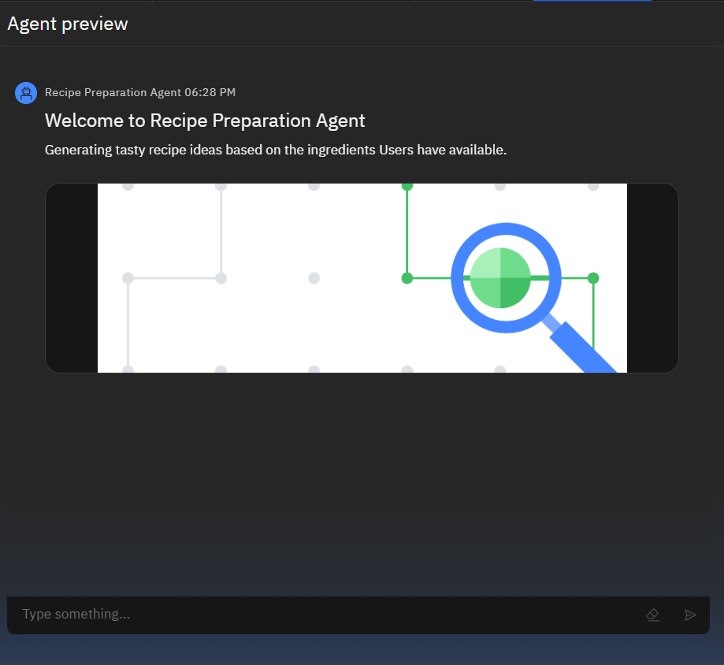
Results

Slide 9
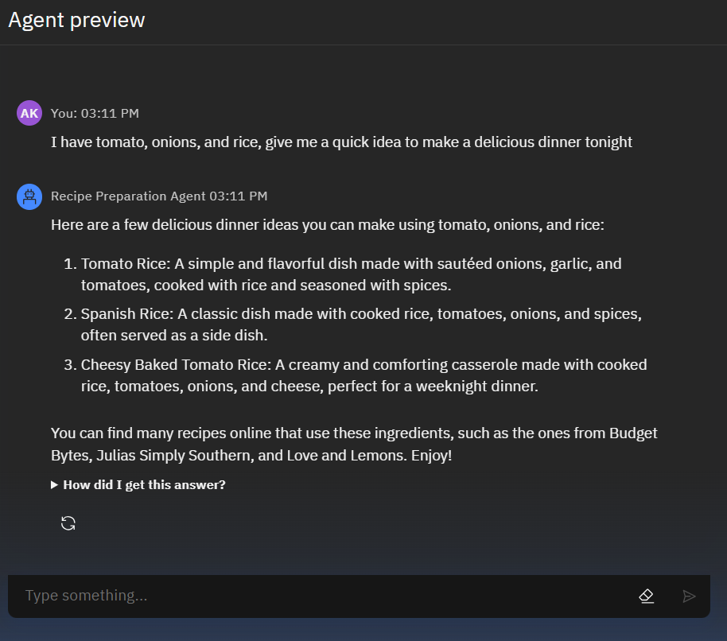
Results

Slide 10
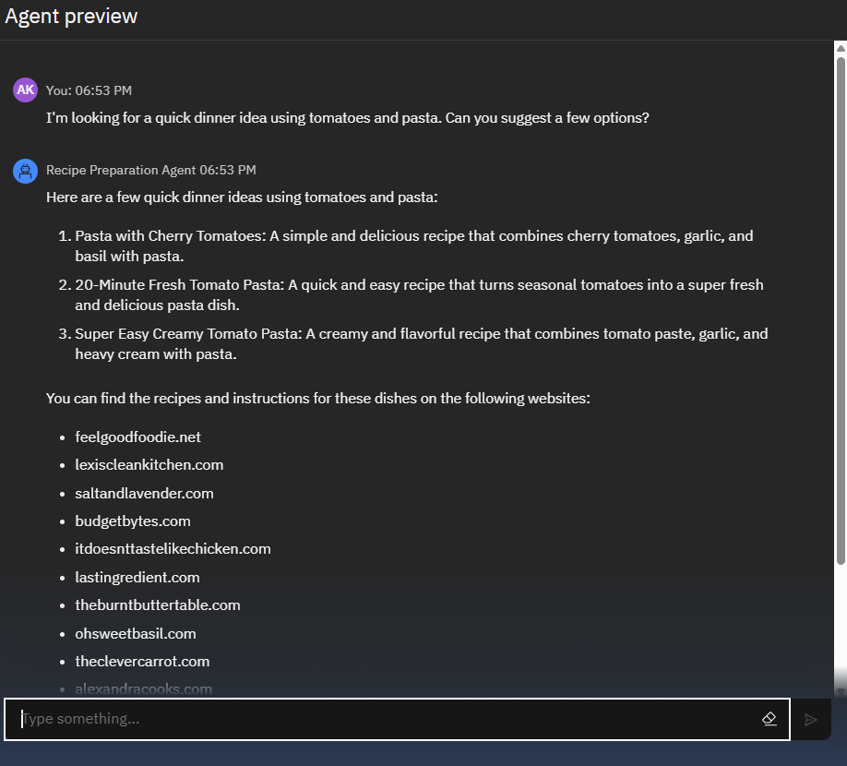
Results

Slide 11
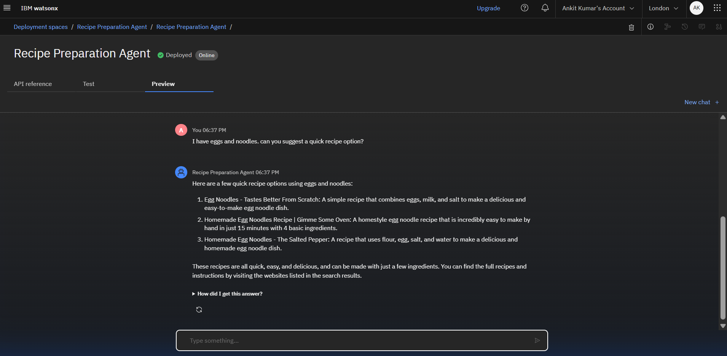
Results
Deployed AI Agent

Slide 12
Conclusion
The Recipe Preparation Agent helps users turn ordinary kitchen items into delicious meals with AI-powered suggestions. It makes homemaking efficient by reducing food waste and optimizing what’s already available.
Saves money, effort, and food
Personalized and easy to use
Can be integrated with kitchen apps/devices

Slide 13
Future scope
Voice input & output for hands-free kitchen use
Multi-language support for regional cuisines
Integration with online grocery ordering
Nutritional tracking and health-focused meal planning
Feedback based recipe improvement

Slide 14
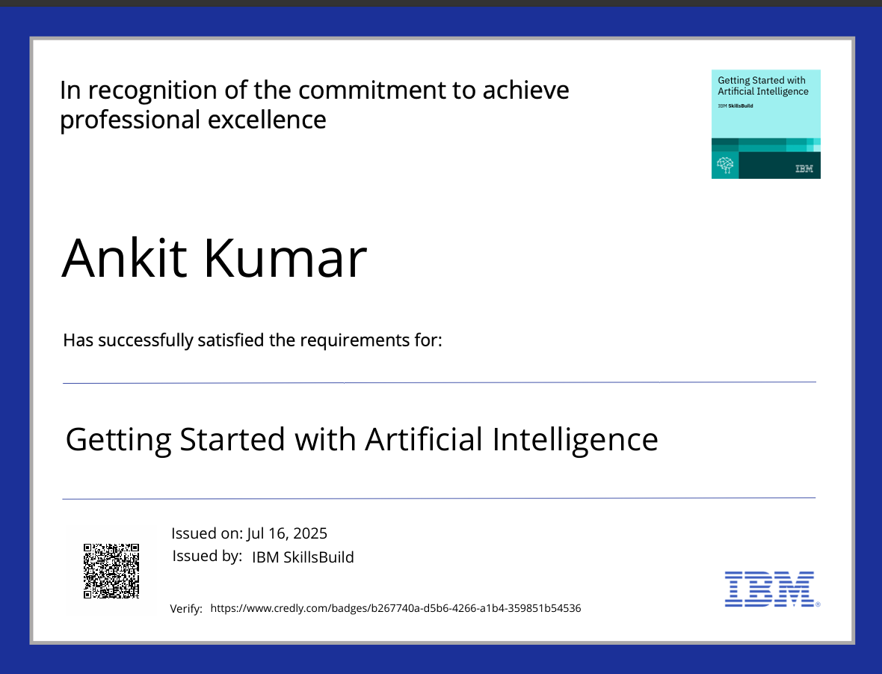
IBM Certifications
Screenshot/ credly certificate( getting started with AI)

Slide 15
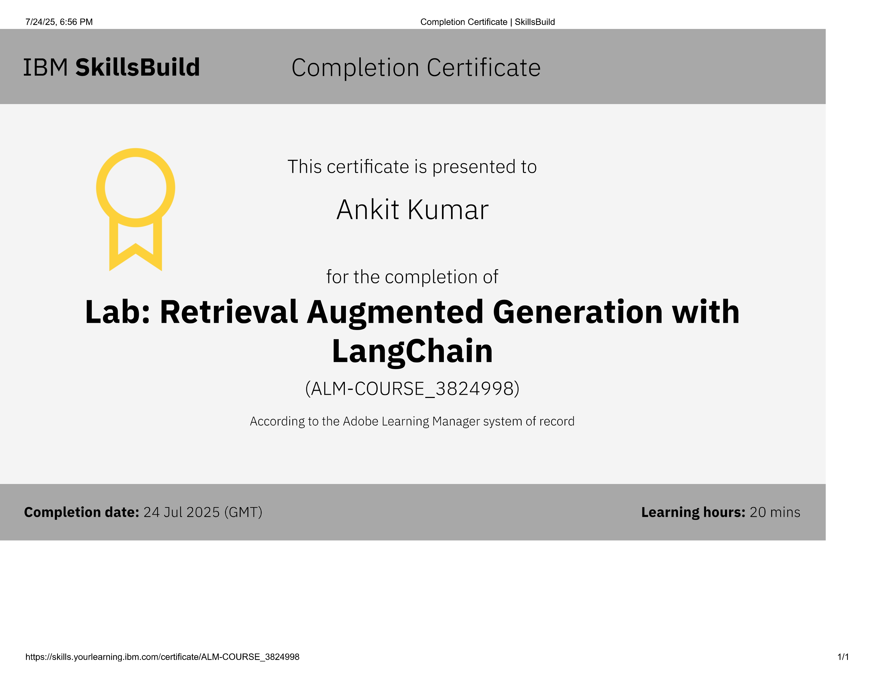
Attach your RAG LAB certificate here

Slide 16
GitHub Link: https://github.com/ChikuX/Recipe-Preparation-Agent

Slide 17
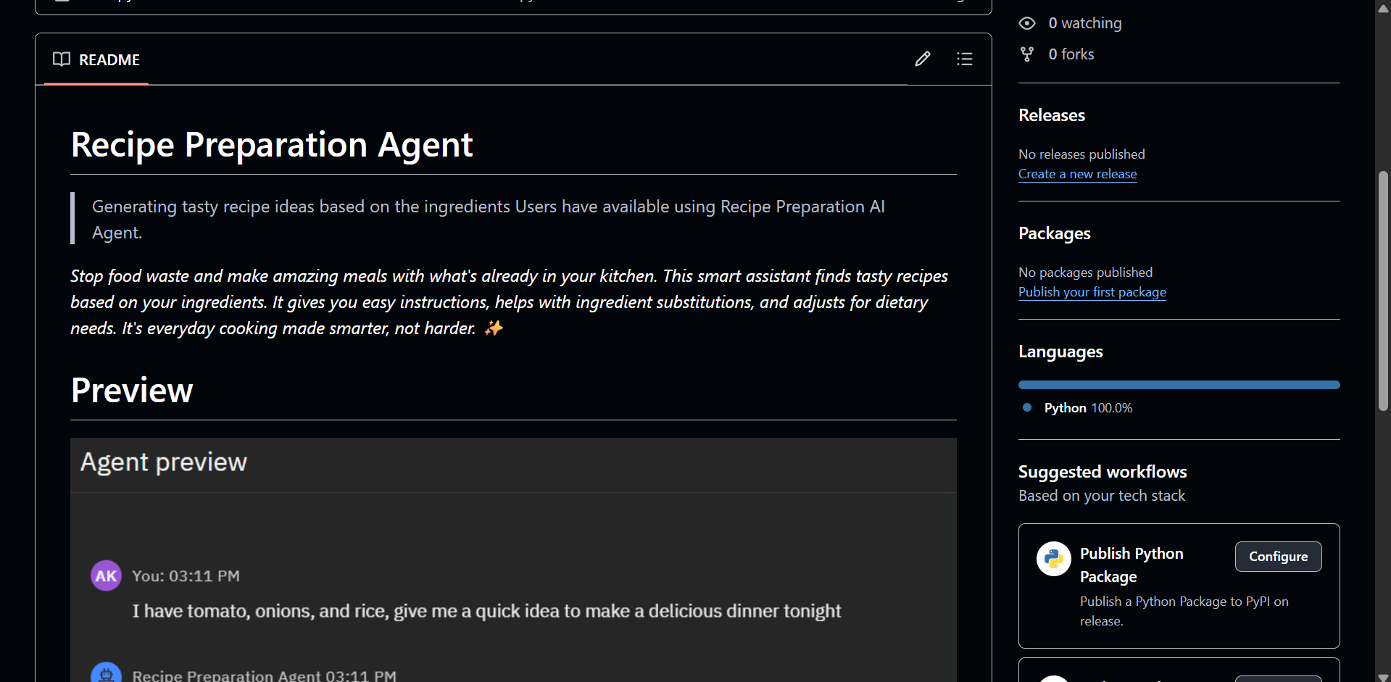
GitHub Link
Make sure that there should be readme file
- https://github.com/ChikuX/Recipe-Preparation-Agent

Slide 18
THANK YOU

